Slide 1
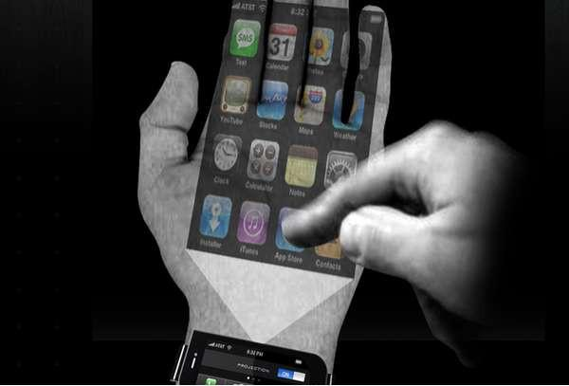
Skinput technology
Skinput technology
skin put technology
Byanandhudinesh

Slide 2
Content
I. Introduction
II. How it works
III. Applications
IV.pico projector
V. Advantages and disadvantages
VII. Future of skin put technology
VIII. Conclusion

Slide 3
Applications
Overview of the various applications of skin put technology: Skin put technology has a wide range of potential applications in various fields such as medicine, gaming, virtual reality, and human-computer interaction.
Medical applications: Medical skin put devices have the potential to improve patient outcomes by providing non-invasive monitoring and therapy. Examples of medical applications include:
Wearable devices for monitoring vital signs such as heart rate, respiration, and temperature
Pain management devices that use electrical stimulation to reduce pain
Wound healing devices that use temperature or light therapy to promote healing
Gaming and virtual reality: Skin put technology can be used to enhance the gaming and virtual reality experience by providing haptic feedback. Examples include:
Gaming controllers with built-in haptic feedback to simulate the sensation of touch
Virtual reality gloves with built-in haptic actuators to provide a more immersive experience
Human-computer interaction: Skin put technology can be used to create new forms of human-computer interaction that are more natural and intuitive. Examples include:
Touch-sensitive interfaces that can be integrated into clothing or other wearable devices
Gesture recognition systems that use sensors to detect movement
Other applications: Skin put technology can also be used in other fields such as telecommunications, robotics, and human-robot interaction.

Slide 4
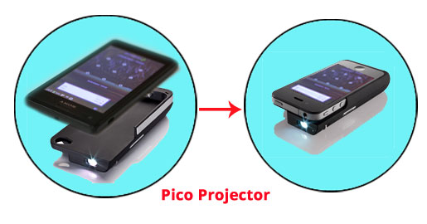
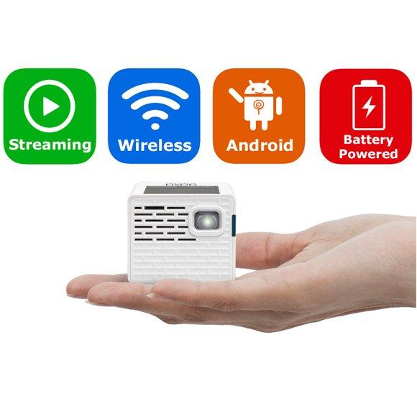
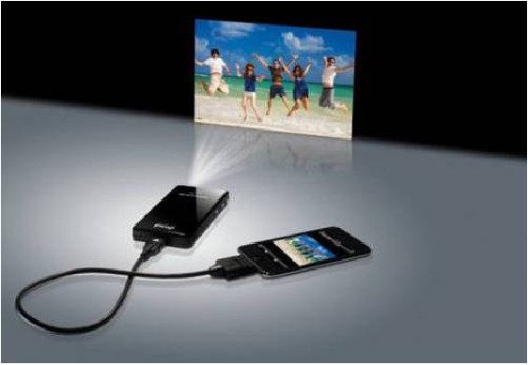
Pico projector
Small sized

Slide 5
Advantages and Disadvantages

Slide 6
Future of skin put technology
Overview of current research and development in the field of skin put technology:
Advancements in materials: Researchers are exploring new materials that are more durable, flexible, and biocompatible to use in skin put devices.
Miniaturization: Researchers are working on miniaturizing the sensors and actuators used in skin put devices to make them even more comfortable to wear.
Development of new sensors and actuators: Researchers are developing new types of sensors and actuators that can detect and interact with the skin in new ways.

Slide 7
Future of skin put technology
Discussion of potential future applications and advancements:
Medical applications: In the future, skin put technology could be used to create more advanced medical devices that can monitor a wider range of vital signs and provide more effective therapies.
Gaming and virtual reality: Skin put technology could be used to create more immersive gaming and virtual reality experiences by providing more realistic haptic feedback.
Human-computer interaction: Skin put technology could be used to create new forms of human-computer interaction that are more natural and intuitive.
Robotics: Skin put technology could be used to create more advanced robots that are able to sense and interact with humans in a more natural way.

Slide 8
Conclusion
Summary of key points: The presentation provided an overview of skin put technology, including how it works, its various applications, and its advantages and disadvantages. It also explored the current state of research and development in the field and discussed potential future applications and advancements.
Discussion of the significance and potential impact of skin put technology: Skin put technology has the potential to revolutionize the way we interact with technology and to improve patient outcomes in the medical field. It has the potential to create more immersive gaming and virtual reality experiences, more advanced medical devices, and new forms of human-computer interaction. As the technology continues to advance, we can expect to see more practical applications of skin put technology in the future, which could have a significant impact on different fields.

Slide 10



